Slide 1


INTERNSHIP PROGRAM
Data Analysis
Prepared by
- Thanesh S.

Slide 2
Project Overview :
Objective :
To analyze restaurant data and identify key insights related to ratings, chains, cuisines, and locations.
Tools & Technologies Used :
Python (Pandas, NumPy)
Data Visualization (Matplotlib, Seaborn, Folium)
Jupyter Notebook

Slide 3
Level 01
Task 01 : Top Cuisines
Determine the top three most common cuisines in the dataset.
Calculate the percentage of restaurants that serve each of the top cuisines.

Slide 4
Determine the top three most common cuisines in the dataset :
Top Three Most Common Cuisines :
After analyzing the Cuisines column in the dataset, the top three most common cuisines were identified based on their frequency of occurrence :
• North Indian – 2,992 restaurants • Chinese – 1,880 restaurants • Fast Food – 1,314 restaurants
These cuisines dominate the dataset, indicating a higher preference and availability across restaurants.

Slide 5
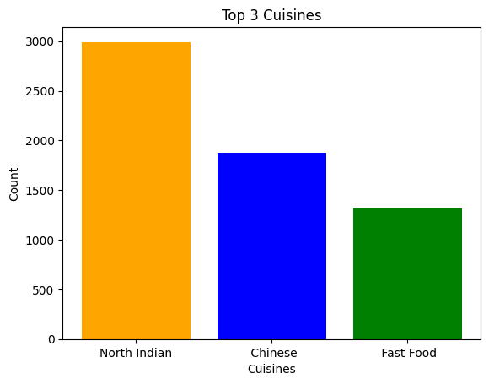
Bar Graph :

Slide 6
Calculate the percentage of restaurants that serve each of the top cuisines :
Percentage of Restaurants Serving Top Cuisines :
The dataset was analyzed to determine the percentage of restaurants serving the most popular cuisines :
• North Indian – 31.33% • Chinese – 19.68% • Fast Food – 13.76% • North Indian (secondary category) – 10.14% • Chinese (secondary category) – 8.95%
The results show that North Indian cuisine has the highest overall presence, followed by Chinese and Fast Food, indicating strong customer preference for these cuisines.

Slide 7
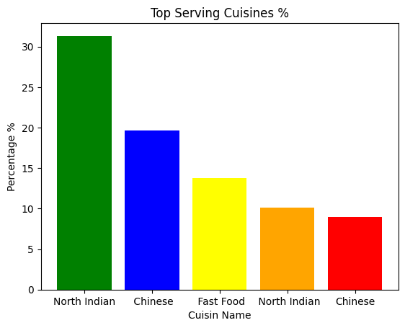
Bar Graph :

Slide 8
Level 01
Task 02 : City Analysis
Identify the city with the highest number of restaurants in the dataset.
Calculate the average rating for restaurants in each city.
Determine the city with the highest average rating.

Slide 9
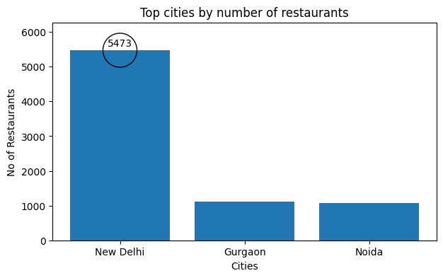
Identify the city with the highest number of restaurants in the dataset.
New Delhi emerges as the city with the highest number of restaurants (5,473), highlighting its dense and diverse food ecosystem.

Slide 10
Calculate the average rating for restaurants in each city :
The average rating for restaurants in each city is :
Abu Dhabi 4.300000
Agra 3.965000
Ahmedabad 4.161905
Albany 3.555000
Allahabad 3.395000
... …
Weirton 3.900000
Wellington City 4.250000
Winchester Bay 3.200000
Yorkton 3.300000
istanbul 4.292857

Slide 11
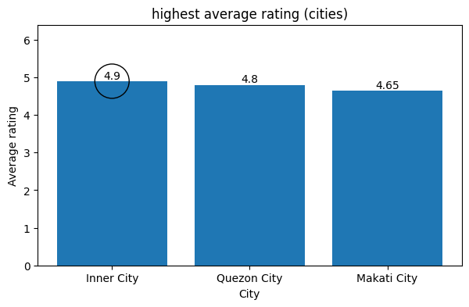
Determine the city with the highest average rating :
The city with highest average rating is "Inner City“ with a rating value of "4.9"

Slide 12
Level 01
Task 03 : Price Range Distribution :
Create a histogram or bar chart to visualize the distribution of price ranges among the restaurants .
Calculate the percentage of restaurants in each price range category.

Slide 13
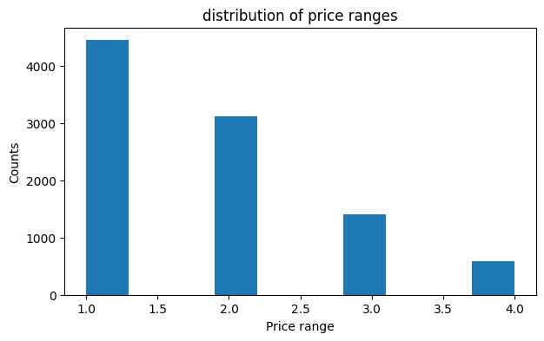
Create a histogram or bar chart to visualize the distribution of price ranges among the restaurants :
The below Histogram shows the various distribution of price ranges among the restaurants .

Slide 14
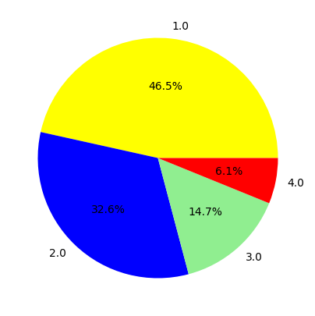
Calculate the percentage of restaurants in each price range category. :
The percentage of restaurants in each price range category are :
1.0 - 46.53%
2.0 - 32.59%
3.0 - 14.74%
4.0 - 6.14%
Pie Chart :

Slide 15
Level 01
Task 04 : Online Delivery :
Determine the percentage of restaurants that offer online delivery.
Compare the average ratings of restaurants with and without online delivery .

Slide 16
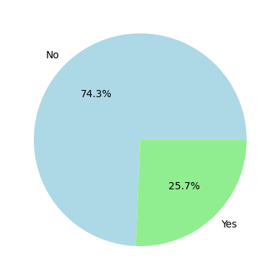
Determine the percentage of restaurants that offer online delivery :
The percentage of restaurant that offers online delivery is : 25.7 %
Pie Chart :

Slide 17
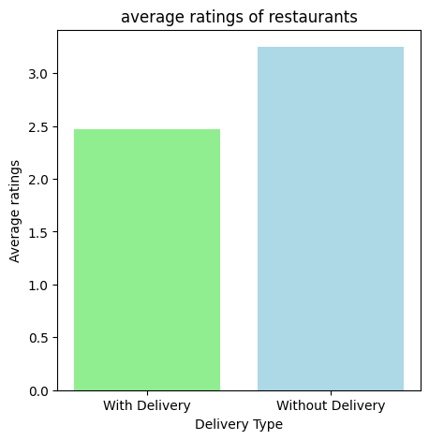
Compare the average ratings of restaurants with and without online delivery :
Bar Graph :
Restaurants with online delivery show a lower average rating “2.47⭐”.
Restaurants without online delivery have a higher average rating “3.25⭐”.
This indicates that online delivery availability is associated with better customer ratings

Slide 18
Level 02
Task 01 : Restaurant Ratings :
Analyze the distribution of aggregate ratings and determine the most common rating range .
Calculate the average number of votes received by restaurants .

Slide 19
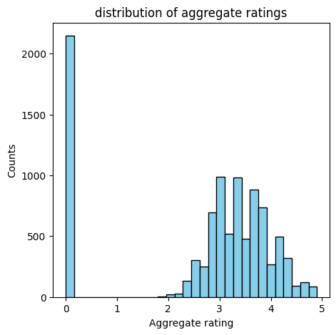
Analyze the distribution of aggregate ratings and determine the most common rating range :
Histogram :
Based on the analysis of aggregate ratings, the most common rating observed in the dataset is “0.0”, with a total count of “2,148” entries .
This indicates that a significant number of restaurants have not received any customer ratings.

Slide 20
Calculate the average number of votes received by restaurants :
The analysis reveals that restaurants receive an average of 156.91 votes,
indicating a moderate level of customer engagement across the dataset.
customer participation is present across the dataset, though it is not evenly distributed among all restaurants.

Slide 21
Level 02
Task 02 : Cuisine Combination :
Identify the most common combinations of cuisines in the dataset.
Determine if certain cuisine combinations tend to have higher ratings.

Slide 22
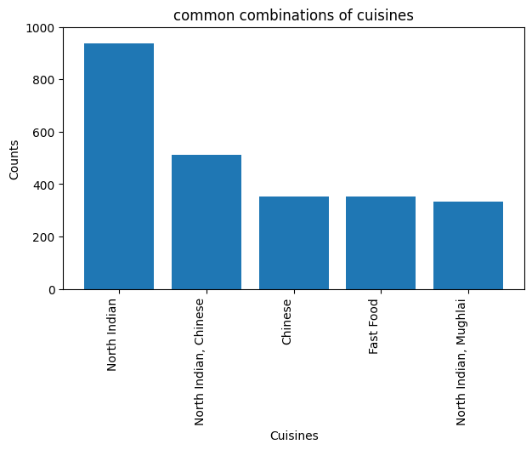
Identify the most common combinations of cuisines in the dataset :
the most common combinations of cuisines in the dataset are :
North Indian - 936
North Indian, Chinese - 511
Chinese - 354
Fast Food - 354
North Indian, Mughlai -334
Bar Chart :

Slide 23
Determine if certain cuisine combinations tend to have higher ratings.
certain cuisine combinations tend to have higher ratings are :
Fast Food - 3.29
North Indian, Mughlai - 3.28
Chinese - 3.23
North Indian - 3.18
North Indian, Chinese - 3.12
This indicates that popular cuisine pairings not only attract more restaurants but also achieve better customer satisfaction.

Slide 24
Level 02
Task 03 : Geographic Analysis :
Plot the locations of restaurants on a map using longitude and latitude coordinates.
Identify any patterns or clusters of restaurants in specific areas.

Slide 25
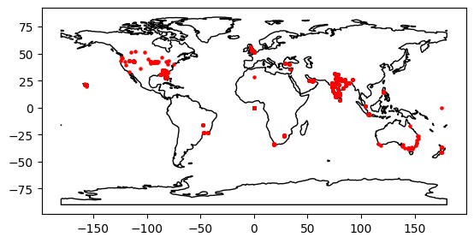
Plot the locations of restaurants on a map using longitude and latitude coordinates :
The location of restaurants have been marked on a map using the given Longitude and Latitude Coordinates .

Slide 26
Identify any patterns or clusters of restaurants in specific areas :
Refer to Diagram in Jupyter Notebook

Slide 27
Level 02
Task 04 : Restaurant Chains :
Identify if there are any restaurant chains present in the dataset .
Analyze the ratings and popularity of different restaurant chains .

Slide 28
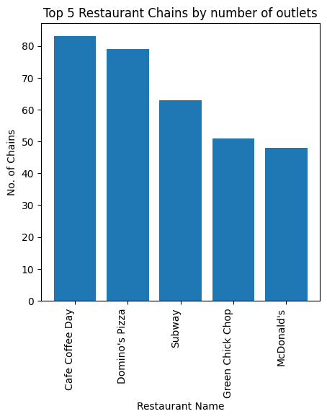
Identify if there are any restaurant chains present in the dataset .
Bar Chart :
There are totally 734 Restaurant Chains present in the dataset .
The Restaurant Chain includes :
Cafe Coffee Day - 83
Domino's Pizza - 79
Subway - 63
Green Chick Chop - 51
McDonald's - 48
……..
San Carlo - 2
Gymkhana - 2
Dishoom - 2
Timboo Cafe - 2
De Verolu - 2

Slide 29
Analyze the ratings and popularity of different restaurant chains .
The ratings of different chain restaurants :
Restaurant Name Average Rating
Solita 4.9
Spiral - Sofitel Philippine
Plaza Manila 4.9
Flat Iron 4.9
Sagar Gaire Fast Food 4.9
Bao 4.9
…………………
Punjabi Special 0.0
Zaika Muradabadi 0.0
Punjabi Shahi Chicken Soup 0.0
Zaika Kathi Roll 0.0
Food On Wheels 0.0
The popularity of different chain restaurants based on the total votes are :
Restaurant Name Total Votes
Barbeque Nation 28142
AB's - Absolute Barbecues 13400
Toit 10934
Big Chill 10853
Farzi Cafe 10098
... ... ...
Frugurpop- ibis New Delhi 0
Frozen Grillz 0
Break Fast Junction 0
Pizza Hot 0
Piyu Fast Food 0

Slide 30
Conclusion :
The analysis reveals a diverse restaurant landscape with a large number of independent outlets as well as well-established restaurant chains.
Popular chains such as Cafe Coffee Day, Domino’s Pizza, and Subway have a strong presence, indicating high customer demand and brand trust.
Geographic analysis highlights clusters of restaurants in prime urban areas, showing higher competition in these locations.
Overall, customer ratings and votes provide valuable insights into customer preferences, helping identify top-performing restaurants and chains.

Slide 31
Thank You !

